Slide 1

Enhancing Performance with SQL Stored Procedures & UDF
by Ravisankar Pandian

Slide 2


Topics covered
What is Stored Procedure?
The What, Why & How
What is UDF?
The What, Why & How
Enhancing Performance for SPs and UDFs
Do’s
Do Not’s
Some good use cases
Tips
New Features
Conclusion
Programmers.io Confidential and Proprietary

Slide 3


Objectives
Take away from the session:
General overview of Stored Procedures & UDFs
Good understating of how UDFs and SPs perform
Best practices for handling larger data / building application logic
Session is Useful for:
RPG Developers
DB2 SQL Developers
Programmers.io Confidential and Proprietary

Slide 4
Stored Procedure – the WHAT?
A Stored Procedure is a compiled program that can execute SQL statements.
Program object is stored on the DB2 database.
It is like running STRSQL and exec-sql but with some special powers.
Stored Procedure can be called from any application program (Java or Python or any front-end app) that has access to the DB2 database.
It can be called from IBMi command line as well.
Programmers.io Confidential and Proprietary
Notes:
SP -> Loops, conditional logic, code blocks, passing parameters etc.,

Slide 5
Stored Procedure – the WHY?
Reduce network traffic.
Locks are not held across the network transmissions.
Centralized code.
Security & Integrity.
Code Reusability.
Easily comprehensible by cross platform teams.
A good skillset to have for IBM’ers.
Programmers.io Confidential and Proprietary

Slide 6
Stored Procedure – with and without
With Stored Procedure | Without Stored Procedure
Decreased Network Traffic | Increased Network Traffic
Reduced Resource Contention (locks) | Increased Resource Contention (locks)
More Security | End Users can manipulate SQL Statements & Variables
Code Reusability | May lead to code redundancy
Encapsulation of Business Logic | Harder to Manage & Update
Easily Comprehensible by other teams | Harder to comprehend the business logic
Programmers.io Confidential and Proprietary
Notes:
N

Slide 7
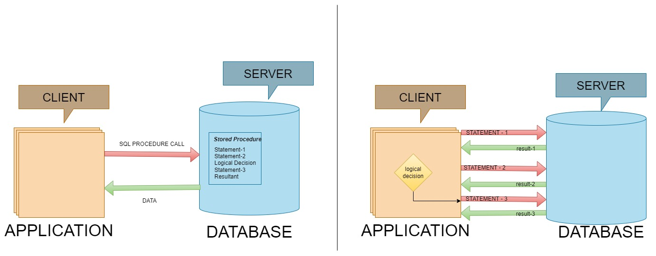
With Stored Procedure
Without Stored Procedure
Programmers.io Confidential and Proprietary
Notes:
A sample note
This is another line

Slide 8
Stored Procedure – the types?
INTERNAL STORED PROCEDURE | EXTERNAL STORED PROCEDURE
Based on procedural extensions to the SQL Language. | Based on high-level-language like C, CL, RPG and COBOL
Straight forward database manipulation | Allows Complex & Sophisticated processing.
For existing systems, business logic need to be ported to SQL Language. | Existing code can be reused.
Open up the IBMi to front-end
Can be used, With and without parameters, With and without result sets.
Programmers.io Confidential and Proprietary
Notes:
Usage of arrays, data structures, built-in-functions, sub-procedures
Core of the business logic can be encapsulated for clients to use.

Slide 9
Stored Procedure – the types?
Based on the type of parameters & definition
TYPES | USE CASE
Without Parameter | Insert predefined records.
With In Parameter | Kick start the Day-End or Month-end process from front-end.
With In & Out Parameter | Get the day of the week in text.
Result sets | Pass the multiple records to the front end
Similarly, we can classify the external stored procedure as well
Programmers.io Confidential and Proprietary
Notes:
Insert 5 records to Depts table.
Insert a employee record with some information.
Get the day of the week.
Get the 20 records of employee table.

Slide 10
Stored Procedure – the HOW?
Let’s see it in action!
Programmers.io Confidential and Proprietary
Notes:
Show catalog tables after creation

Slide 11
User Defined Function– the WHAT?
UDFs are custom functions created by developers within the DB2 database on IBMi.
Can encapsulate SQL logic and can return a single value (scalar) or an entire table (table-valued).
Program object is stored on the DB2 database.
It can be invoked only in SQL Statements
Programmers.io Confidential and Proprietary
Notes:
SP -> Loops, conditional logic, code blocks, passing parameters etc.,

Slide 12
User Defined Function – the WHY?
Modularity & Code Reusability
Performance Optimization
Code abstraction & Encapsulation
Centralized code.
Data formatting.
Programmers.io Confidential and Proprietary
Notes:
Breakdown complex logic into smaller, reusable units
UDFs can improve query performance by precomputing results or handling repetitive tasks efficiently. Non-deterministic
Execute common calculations or transformations efficiently.
Think it like the BIF in RPGLE.

Slide 13
Stored Procedure – the types?
Based on the type of definition
TYPES | USE CASE
Scalar Function | Insert predefined records.
User Defined Table Function | Returns a table upon calling.
Programmers.io Confidential and Proprietary
Notes:
Insert 5 records to Depts table.
Insert a employee record with some information.
Get the day of the week.
Get the 20 records of employee table.

Slide 14
User Defined Function– the HOW?
Let’s see it in action!
Programmers.io Confidential and Proprietary
Notes:
Show catalog tables after creation

Slide 15
Dos and Don’ts
Choose built-in-functions over User-defined-function
Use not fenced clause to reduce overhead
Use deterministic for scalar math functions
Use “no external action” for internal functions.
Programmers.io Confidential and Proprietary
Notes:
Show catalog tables after creation

Slide 16
New features
Arrays
Sequence
Data Area accessibility
Create Custom Data Type
Programmers.io Confidential and Proprietary
Notes:
Show catalog tables after creation

Slide 17
Questions and Answers
Thank you

